Slide 1
Customer Retention and Sentiment Forecasting
Amazon Prime Pantry

Slide 2
Introduction
Many consumers are effectively influenced by online reviews when making their purchase decisions.
The customer sentiments plays a vital role in giving a quick overview of the product quality.
The purpose of this project is to develop models that are able to analyze customer’s sentiments.

Slide 3
Dataset Information
The dataset is from Amazon product data, which contains product review and metadata from Amazon, including 142.8 million reviews.
In this project, we use 5-core and ratings only data from the Base dataset (https://jmcauley.ucsd.edu/data/amazon/). These two file contains reviews and rating related columns, we use meta data dataset of Amazon Prime Pantry, which is subset of the data.

Slide 4
Data Preparation and Preprocessing
Data Fetching
Reading the Data
Merging Data-Merging the 5 core data with meta data
Dropping the irrelevant columns
Performing the Missing Value Treatment : Treatment done by forward and backward fill in the price column.
Exploratory Data Analysis

Slide 5
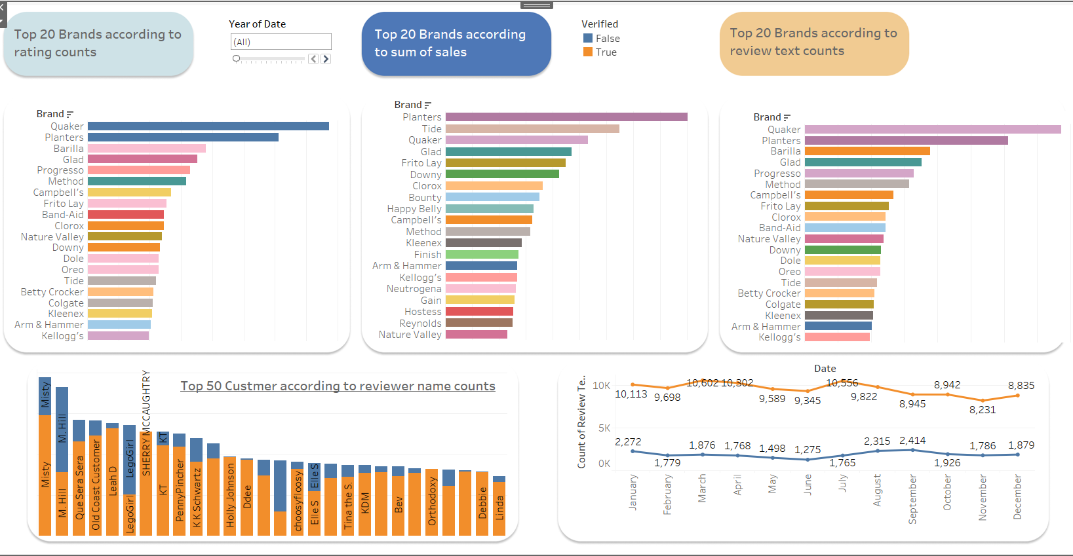
Exploratory Data Analysis.

Slide 6
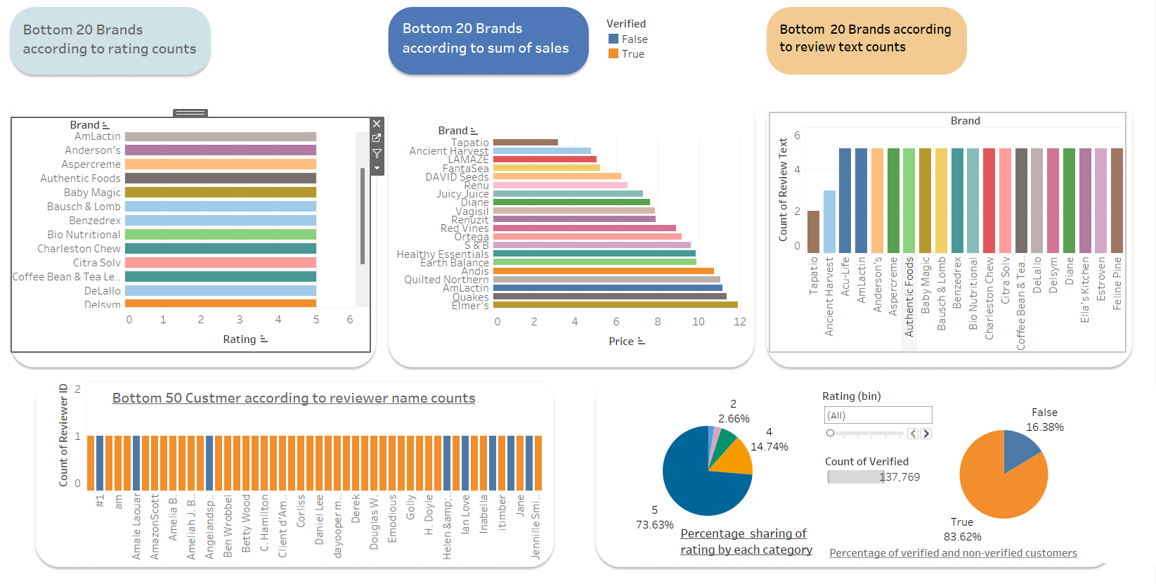
Exploratory Data Analysis

Slide 7
Data Preparation and Preprocessing(contd…)
Removing Special Characters from the sentences.
Removing Stop Words.
Lemmatization.
Polarity.

Slide 8
Modelling and Machine Learning
Classification Models:
Logistic Regression : Logistic regression is a statistical method for predicting binary classes. It computes the probability of an event occurrence.
Multinomial Naïve Bayes : Multinomial Naive Bayes algorithm is a probabilistic learning method that is mostly used in Natural Language Processing (NLP). The algorithm is based on the Bayes theorem and predicts the tag of a text
Decision Tree Classifier : A decision tree is a flowchart-like tree structure where an internal node represents feature(or attribute), the branch represents a decision rule, and each leaf node represents the outcome.
K Nearest Neighbor Classifier : KNN is a non-parametric learning algorithm. Non-parametric means there is no assumption for underlying data distribution.

Slide 9
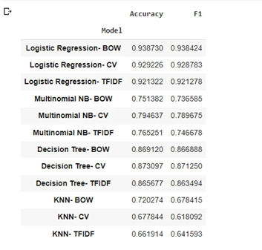
Classification Model Results
According to Accuracy & F1 score we can observe that in Logistic Regression by Bag Of Word method we are getting highest Accuracy & F1 score ,but as we know that Bag of Word method doesn’t consider the order of the words. Because of that our Meaning/ Context of the sentence may get change. So bag of word method wasn’t reliable to predict the sentiments.

Slide 10
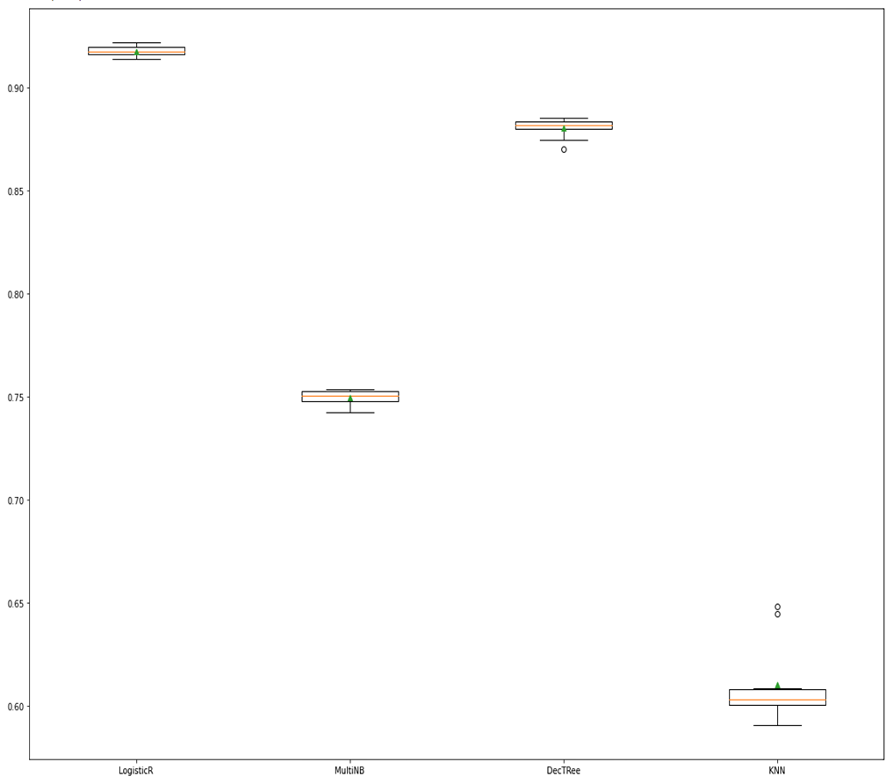
TF-IDF vectorization method with cross validation.
From the visuals we can say that the Logistic Regression model gets the higher F1 score (91.8%) among all the models.

Slide 11
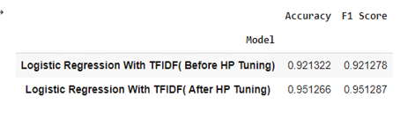
Hyperparameter Tuning
Hyperparameter tuning of the model is required to get better accuracy & precision for better model.
Applying Grid Search CV method to get the best hyperparameter for our model.

Slide 12
Clustering Algorithms.
K-Means algorithm: The k-means algorithm is one of the most popular clustering algorithms. It classifies the dataset by dividing the samples into different clusters of equal variances.
DBSCAN Algorithm: It stands for Density-Based Spatial Clustering of Applications with Noise. . In this algorithm, the areas of high density are separated by the areas of low density.
Agglomerative Hierarchical algorithm: The Agglomerative hierarchical algorithm performs the bottom-up hierarchical clustering.

Slide 13
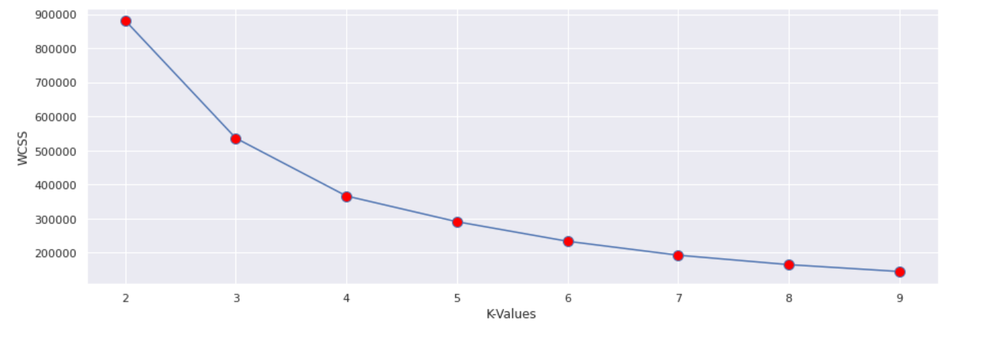
Elbow Method
The Elbow method is one of the most popular ways to find the optimal number of clusters.
From the plot, we can see the elbow point is at 3. So the number of clusters here will be 3.

Slide 14
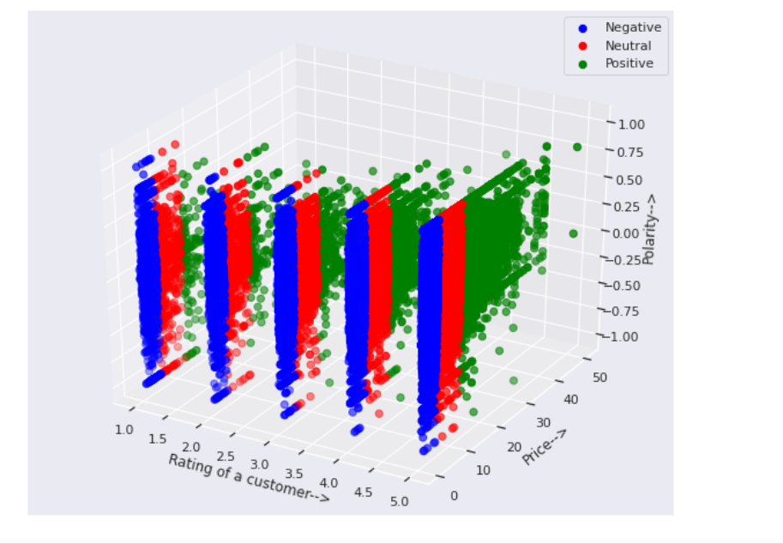
Clusters
From the above graph, we can
say that as the rating and the
price increases, Positive
reviews also increases. For low
rating, the reviews are very
less.

Slide 15
Time Series Analysis
Time Series Components:
Secular (Trend):
Uptrend: Time Series Analysis shows a general pattern that is upward then it is Uptrend.
Downtrend: Time Series Analysis shows a pattern that is downward then it is Downtrend.
Horizontal or Stationary trend: If no pattern observed then it is called a Horizontal or stationary trend.
Cyclic (Trend)
Seasonal Variations
Random or Irregular Movement

Slide 16
Time Series Models
ARIMA : Autoregressive Integrated Moving Average
ARIMA is a combination of multiple forecasting principles. The Autoregressive model (AR) is a representation of a random process.
SARIMAX : Seasonal Autoregressive Integrated Moving Average
SARIMA or Seasonal ARIMA, is an extension of ARIMA that explicitly supports univariate time series data with a seasonal component. All things remain same as ARIMA model but new seasonality elements are added.

Slide 17
ACF and PACF
Autocorrelation function (ACF) is a measurement of how related the actual value is to the previous values including trend and seasonality. The values are plotted along a confidence interval band (typically 0.05, 0.025 etc). It is the q/Q component of ARIMA/SARIMA model.
Partial Autocorrelation function (PACF), unlike the ACF, finds the correlation between the residual values in the series, therefore it is only the partial function. The values are plotted along a confidence interval band (typically 0.05, 0.025 etc). It is the p/P component of ARIMA/SARIMA model.

Slide 18
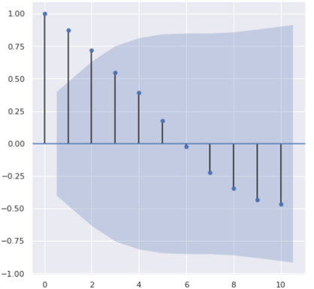
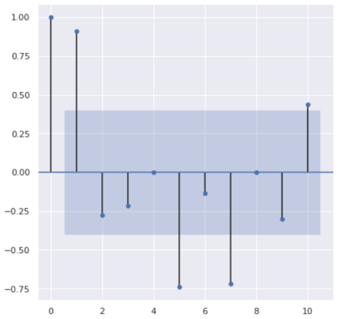
ACF and PACF Plot
Autocorrelation
Partial Autocorrelation

Slide 19
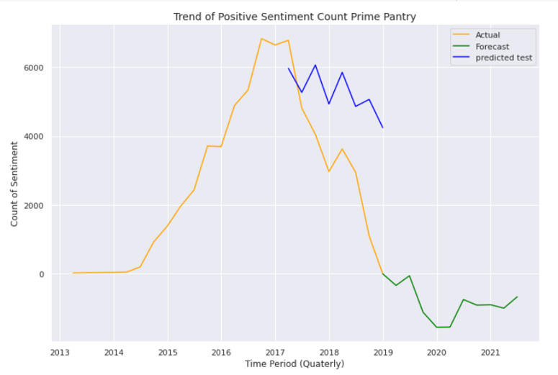
Trend of Positive Sentiments
From the plot, we can say that the positive sentiments of customers will decrease till 2020 and after that it will increase, as per shopping habits of people.

Slide 20
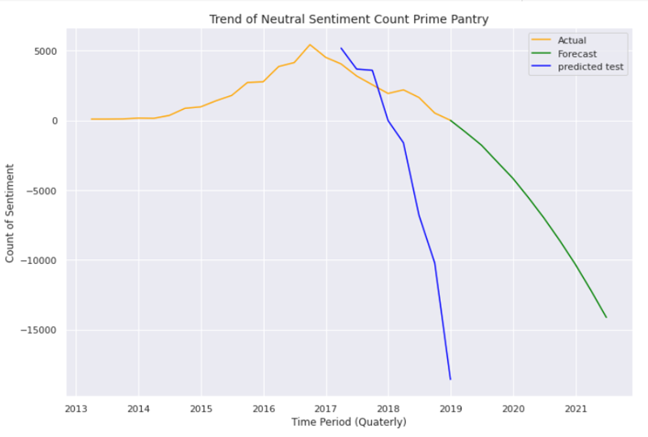
Trend of Neutral Sentiments.
From the plot, we can analyze that the neutral sentiments of the customers will see a gradual decrease after 2019.

Slide 21
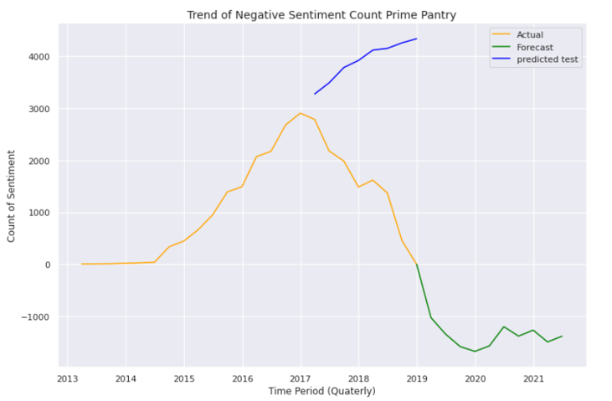
Trend of negative Sentiments.
From the plot, we can analyze that the negative sentiments have gradually decreased till 2020 and after that it has increased slightly.

Slide 22
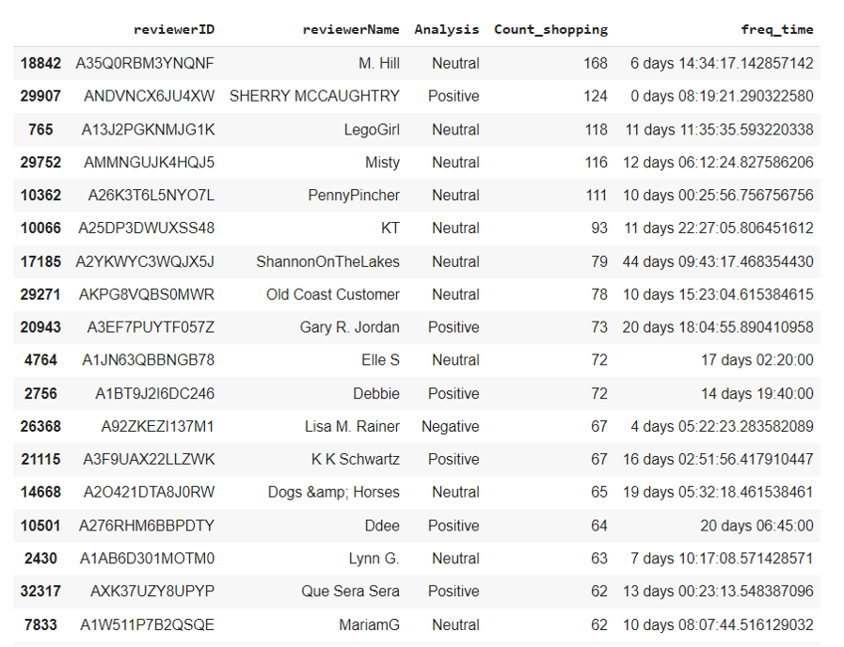
Conclusion Customers on whom brands should focus

Slide 23
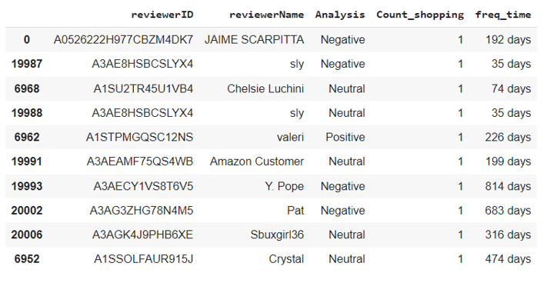
Conclusion…. Customers most likely to churn out

Slide 24
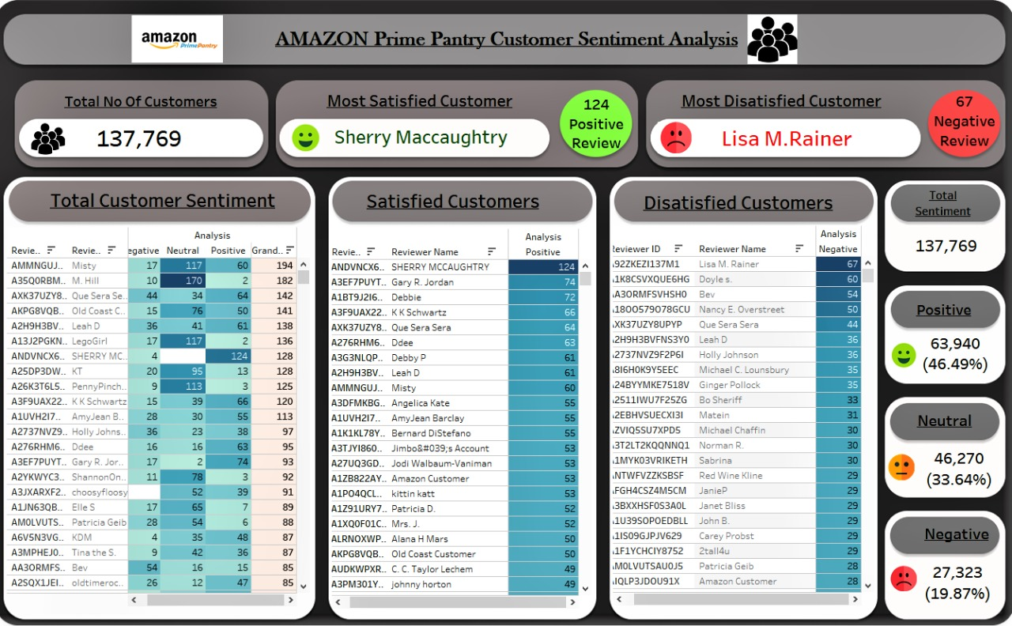
Conclusion… Customer Sentiment Analysis

Slide 25
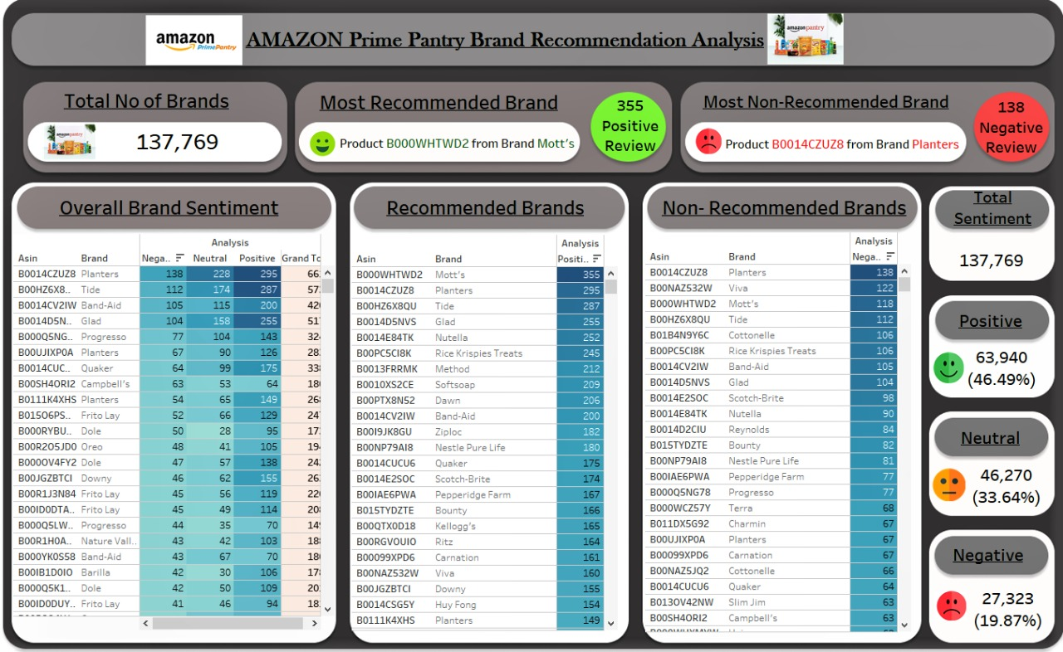
Conclusion… Brand Recommendation Analysis

